Slide 1
Spring Testing using JUnit
Software Testing Boot Camp

Slide 2
Agenda
What is Junit?
Testing a Spring Service with a SQL Backend
Discussion of the sample application to be tested
Testing the Controller Layer
Testing the Service Layer
Testing the Repository Layer
Testing a Spring Service that connects to a 3rd party API
Integration Testing

Slide 3

What is Junit?
An open source “unit testing” framework for JAVA
Used to write and run repeatable automated testing
Plays a big role in regression testing
Provides annotations to identify test methods
Provides assertions for testing expected results
Provides test runners for running tests
Notes:
Testing is the process of checking the functionality of an application to ensure it runs as per requirements.
Unit Testing is at the developer’s level, it is the testing of single entities such as a class or a method.
Unit testing can be done in two ways − manual testing and automated testing.
But we are more leaning to the automated testing because it is fast, less investment in human resources, reliable and programmable.
Unit Test Case is a part of code, which ensures that another part of code (method) works as expected.
Regression testing is re-running functional and non-functional tests to ensure that previously developed and tested software still performs after a change.

Slide 4
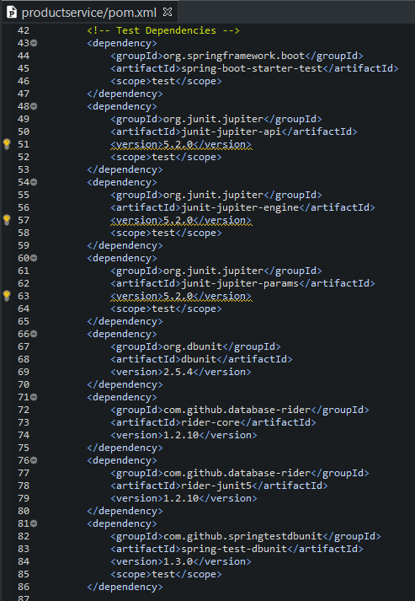
Set-up
Maven Dependencies
Add the necessary dependencies in the pom.xml

Slide 5
Testing a Spring Service with a SQL Backend
Sample application and scope of this bootcamp.
Spring Boot Microservice
Product Controller
Product Service
Product Repository
Product Database
ID | Primary Key
Name | Name of Product
Quantity | Inventory
Version | Product Version
Notes:
Product Controller handles the web request
Then it will call the Product Service that implements the business logic.
And then it will call the Product Repository to persist product to and from our Product Database.
The product controller, service and repository are packaged together into a Spring Boot microservice.
A product model contains an Id, name, quantity and version which we’ll used in the product operations to check if they are valid or not.
The microservice is build in Springboot which supports the Rest Controller, has Autowiring and it is more in the Convention rather than the Configuration.
Meaning, spring automatically discovers the controllers, service and repository in a package.

Slide 6
Testing the Controller Layer
The following are the roles of the controller:
Receives a request from a web client.
Calls the product service to implement the business logic.
Returns the web response in a form of JSON and HTTP Headers
Notes:
Remember the HTTP Methods (GET, POST, PUT, DELETE)
In short, the controller is responsible for handling the web request and generating web responses.

Slide 7
Testing the Controller Layer
What is our testing strategy?
Mock MVC
Product Controller
Mock Product Service
Unit Test
Create a Unit Test that utilizes Mock MVC to test the Product Controller that will call a Mock Product Service.
Mock MVC allows us to execute HTTP Request, validates the HTTP Response, HTTP Headers and Response Body.
Notes:
MockMVC class is part of Spring MVC test framework which helps in testing the controllers explicitly starting a Servlet container.
Create a Unit Test that utilizes Mock MVC to test the Product Controller that will call a Mock Product Service.
Allows us to execute an HTTP Request
Defines RequestBuilders that helps us define the request
Set any HTTP Header that we need
Specify a JSON payload
Allows us to validate the HTTP Response
Mock the Response code that we would be expecting
Mock the Content-type that is being returned
Defines a set of ResultMatchers that is used to in conjunction with the expectations of the response.
Allows us to validate HTTP Headers
Examine the http headers by using the ResultMatchers
Allows us to validate Response Body
Since the controller will be passing JSON Response we will use the ResultMatchers extract the fields from the response and compare them to our expected values.

Slide 8
Testing the Controller Layer
How to test it?
@ExtendWith(SpringExtension.class)
@SpringBootTest
@AutoConfigureMockMvc
class ProductControllerTest {
@MockBean
private ProductService service;
@Autowired
private MockMvc mockMvc;
…
}
Notes:
@ExtendWith(SpringExtension.class)
SpringExtension(JUnit5) receive callback notifications during the Junit lifecycle and this extension uses these to manage our application context.
@SpringBootTest
It tells Spring to load the application context and wires dependencies that you need in your tests without having to instantiate nor configuring them.
@AutoConfigureMockMvc
Create and configure MockMvc meaning it enables the automatic configuration of a new MockMvc instance
@MockBean
Create a mock version of the service that you need by using Mockito, a popular mock framework often used with Junit.
@Autowired
Autowires a MockMvc instance into the test class

Slide 9
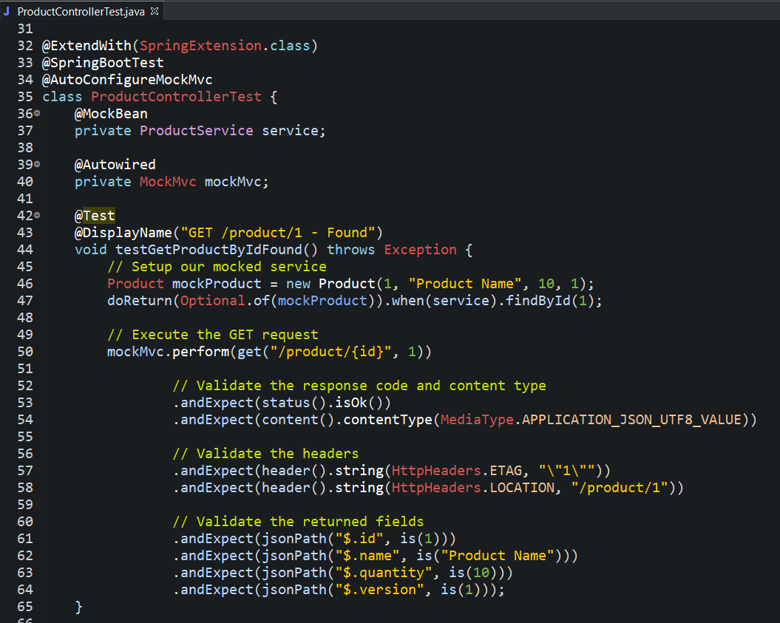
Testing the Controller Layer
Walkthrough

Slide 10
Testing the Service Layer
The following are the roles of the service:
Find
Save
Implements the business processes and logic
Serves as the abstraction layer between the controller and back-end dependencies.
Responsible in connecting to the correct dependency and retrieving the data needed.
Update
Delete
Notes:
Remember that the service functionality allows us to the following:
Find - using the id or retrieve all
Save - which creates a new data
Update – an existing data
Delete – removes an existing data

Slide 11
Testing the Service Layer
What is our testing strategy?
Unit Tests
Product Service
Mock Product Repository
Create a mock product repository.
Wire it to the product service.
Test various scenarios by configuring the response from the mock product repository validating the response from the service.

Slide 12
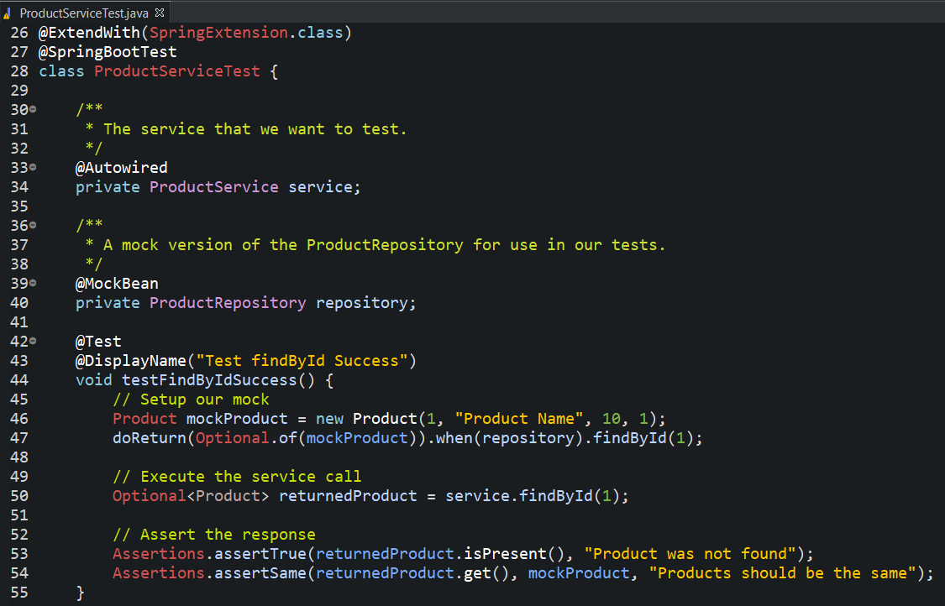
Testing the Service Layer
Walkthrough

Slide 13
Testing the Repository Layer
The following are the roles of the repository:
Provides two methods to find products:
findAll() which returns all products in the database
findById() which returns the product of a specified ID
Provides a save method that persist new products to the database
Provides update method that updates an existing product
Provides delete method that removes a product from the database

Slide 14
Testing the Repository Layer
What is our testing strategy?
Unit Tests
Product Repository
Product Database
DB Unit
Setting Spring Profiles and Database Configuration
DB Unit allows us to populate our dataset with a known set of data and write tests against the set of data

Slide 15
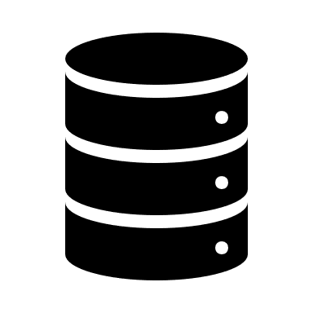


Testing the Repository Layer
How to test it?
DB Unit and DBUnit Extension
DB Setup
DB Refresh
Load test data into your database
Delete all data and setup database before each unit test
Notes:
We will also used the DBUnit and DBUnitExtension
It setups our database using YAML or configuration file and then it will erase database and refresh it from the YAML file before running ever test.
This enables us to work on a against a known set of data and to be sure that our test unit tests have a consistent set of data every time they run

Slide 16
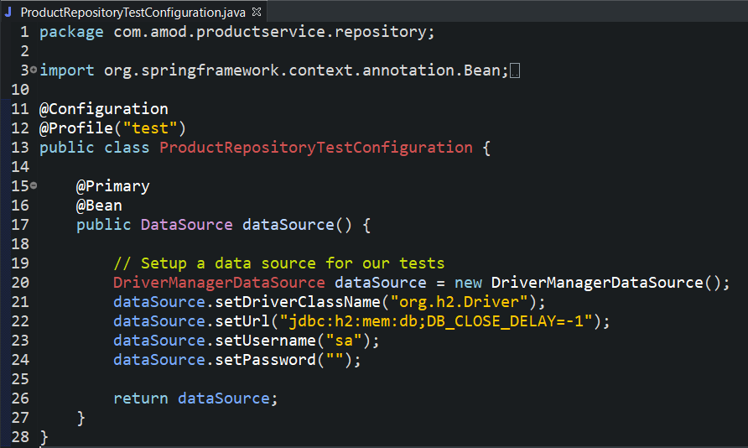
Testing the Repository Layer
How to test it?
Notes:
For the sample demo: H2 Database engine is being used. It is relational database management system written in Java.
This class looks like the other spring test sample but the difference are:
The class is annotated with the Profile test annotation.
@Configuration
Spring Configuration Class
@Profile(“test”)
Spring Profile: “test”
Spring allows us to define profiles to limit the scope of our configurations.
So in our configuration, only test active profiles will be activated whereas our production repository will not. Therefore our test class will only use the test dataSource that we applied and when the application runs in production it won’t use it.
@Primary
This tells spring that the configuration is used and that this bean should “override” any other beans of the same type, and hence be the Primary. So when running in production we will not load this configuration.
@Bean
Create a new DataSource Bean for testing
Configure the data source

Slide 17
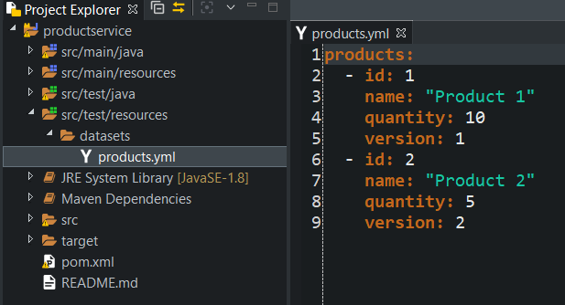
Testing the Repository Layer
How to test it?
@Test
@DataSet(“products.yml”)
void testMethodName() { … }
Notes:
We will be using a products.yml which contains the dataset that we need for our unit testing.
It is located in the src/test/resources/datasets/products.yml
@DataSet
Defining this will reference the dataset to be used for the testing.

Slide 18
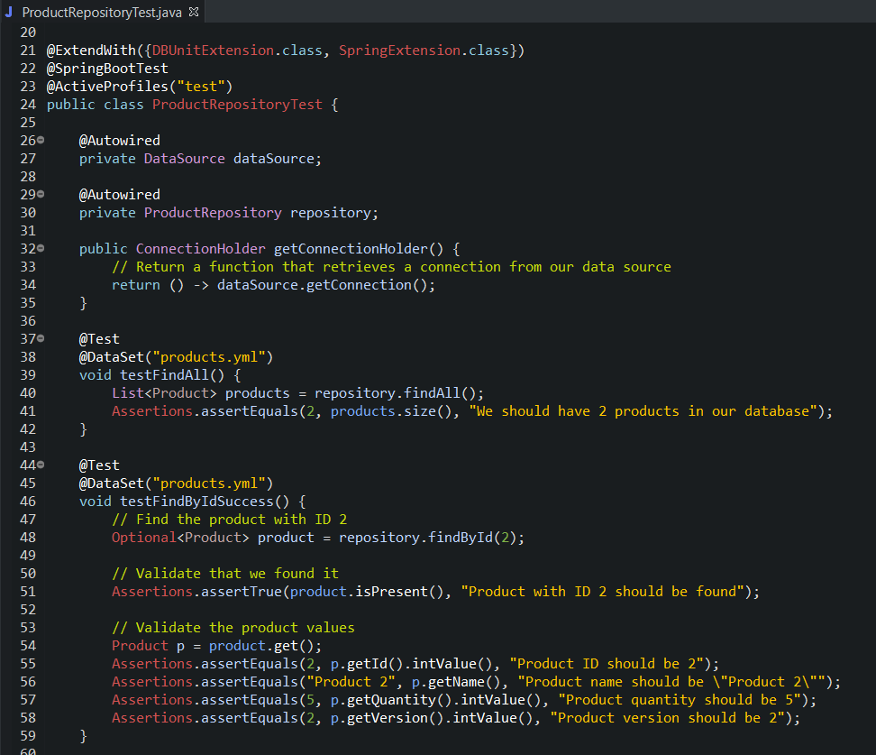
Testing the Repository Layer
Walkthrough

Slide 19

Testing Spring Service that connects to a 3rd party API
We can use WireMock in testing a third party API
Enables us to test our services without actually connecting to a real back-end server
It allows us to stub HTTP responses for use in test environments, as well as unit tests.
It can provide stubs for services that doesn’t exist yet.
We can write tests for services that make web service calls by pointing those services WireMock in our test cases and return a known set of responses.
Notes:
We might used this if the actual third party API is not readily available. Because there are some cases when there are a couple of teams that are working in parallel, this might cause a delay (waiting time) to deliver their services before we can implement our own. By using Wiremock we could agree on a specific interface that a service will throw at us and then work against a stub so that the development is not blocked.
This allows us to test code paths, try to test missing data or simulate authentication errors.
References:
http://wiremock.org/
https://mvnrepository.com/artifact/com.github.tomakehurst/wiremock

Slide 20
Testing Spring Service that connects to a 3rd party API
How does this work?
Unit Test
Inventory Service
Request/
Response Configuration
WireMock Server
Create a WireMock server in our unit test and configure the request that we would like to handle and the response to return for those request.
Configure the service url to point to the WireMock server then WireMock will return the configured responses.
Notes:
WireMock support mapping files.
Mapping Files defines the request to handle and the response to return. Inside the mapping file, the response points to a file in the __files directory that contains the payload to return as the response body.

Slide 21
Testing Spring Service that connects to a 3rd party API
How to test it?
@SpringBootTest
class InventoryServiceTest {
@Autowired
private InventoryService service;
private WireMockServer server;
@BeforeEach
void beforeEach() {
server = new WireMockServer();
server.start();
// Configure req.res
}
@AfterEach
void afterEach() {
server.stop();
}
}

Slide 22
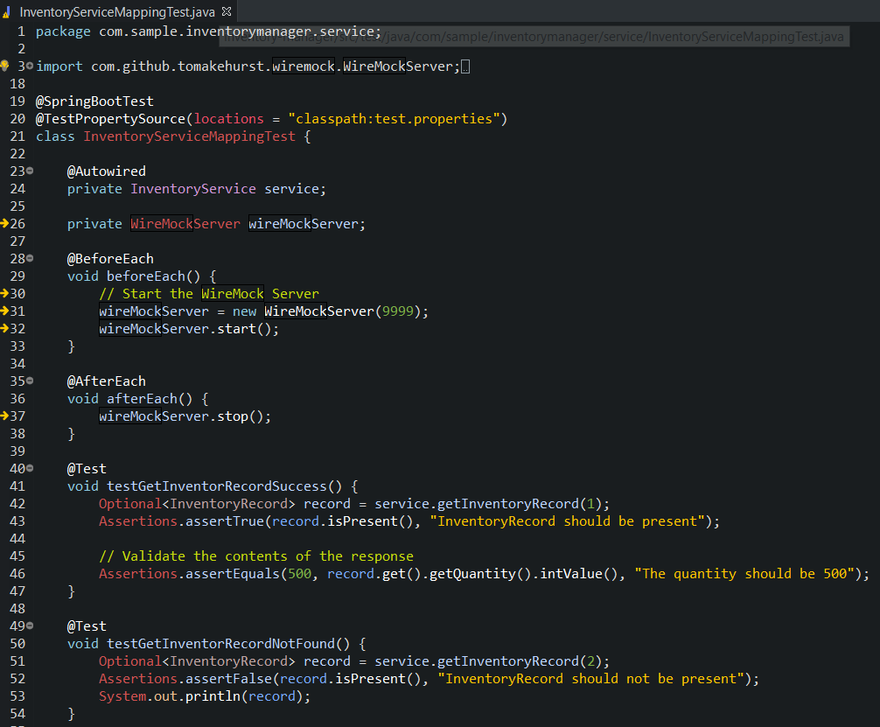
Testing Spring Service that connects to a 3rd party API
Walkthrough

Slide 23
What is Integration Testing
As per Martin Fowler has said:
“Integration tests determine if independently developed units of software work correctly when they are connected to each other.
Notes:
How do we make sure that the controller, service and repository are working together?
We need to build a set of integration tests that will communicate with each other end to end.
We would like to test that if the controller request then the service will resolve to call the proper repository that accurately interacts with database.
Why Integration Testing?
Correct Configuration. We would like to know if all our components are wired correctly with each other.
End-to-end Functionality. We would like to exercise that our application is working it’s correct functionality.

Slide 24
What is Integration Testing?
What is our testing strategy?
Mock MVC
Web Service
Backend Resource
Unit Test
Load the full spring application context and test using Mock MVC.
This means we will wire the components (controllers, service and repository) with each other.

Slide 25
Thank you!
Notes:
Documents and source code reference are uploaded in git: https://github.dxc.com/sbautista3/spring-junit-sample

